Slide 1
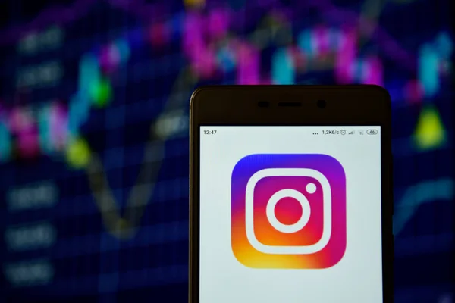
Instagram
User
Analytics

Slide 2
Project Description
I am currently engaged in a project focused on analyzing Instagram users. This involves tracking various activities such as post likes, follower counts, comments, and hashtag usage, as well as determining the total number of registered users on the app.
By utilizing this data, we can uncover valuable insights such as daily active user trends, engagement per day and the quantity of posts being uploaded. We can also identify which hashtags are currently popular.
These insights play a crucial role in making informed decisions about potential future app enhancements or additions.

Slide 3
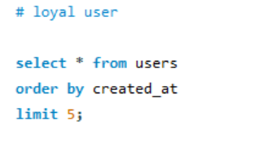
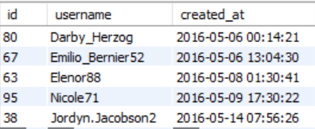
Loyal User Reward

Slide 4
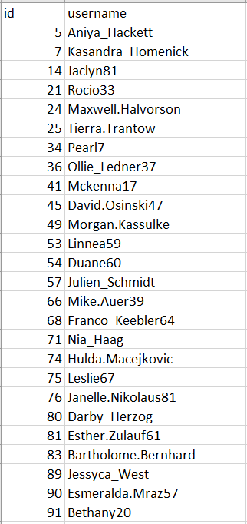
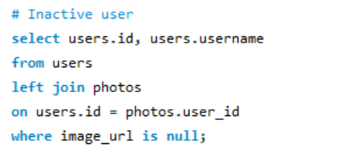
Inactive User Engagement

Slide 5
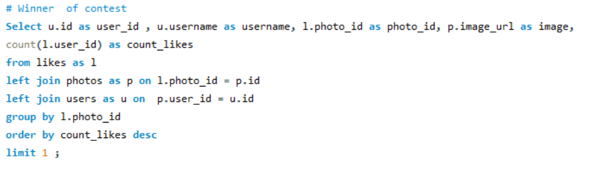

Contest Winner Declaration

Slide 6
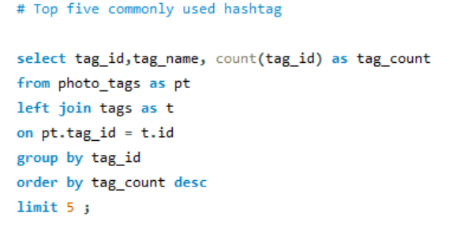
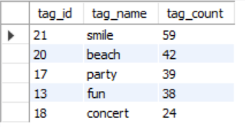
Hashtag Research

Slide 7
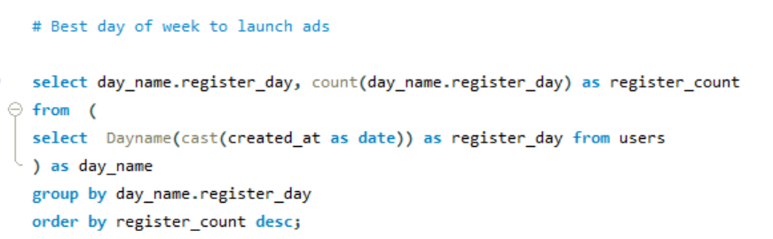
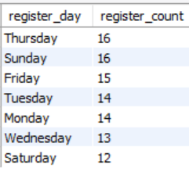
Ad Campaign Launch

Slide 8
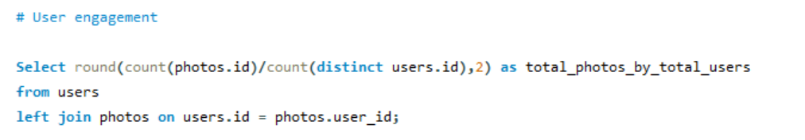

User Engagement

Slide 9
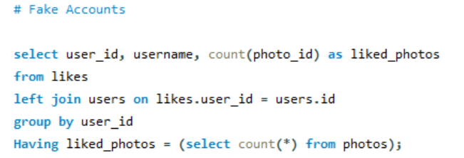
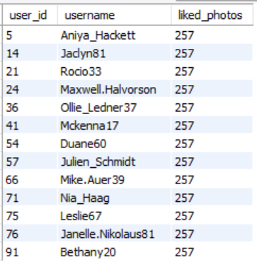
Fake Accounts

Slide 10
Conclusion
For this project, I employed MySQL Workbench in conjunction with Server version 8.0.34.
Upon analyzing this data, I discovered that a quarter of the registered users on the app are inactive. This highlights the need to introduce compelling features to enhance user engagement, subsequently increasing the count of daily active users. Additionally, the analysis revealed that user activity tends to peak towards the end of the week, with lower engagement observed on Mondays and Tuesdays. This prompts consideration on strategies to reduce the presence of fake accounts and initiatives to encourage users to share more photos.

Slide 11

THANK YOU

